Slide 1


BlackJack Project
Yanis Benneouala
Rana Youssef
Sandrine Prevot
Data Analytics
Paris,
5 décembre 2021

Slide 2
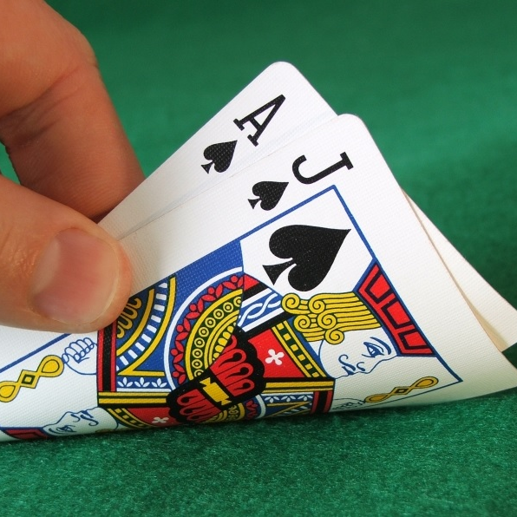
Project Description
Build your own game: the BlackJack, a popular card game.
We will create a game that interacts with the user.
We will using the functions and basic python ressources and functions.

Slide 3
RULES
The rules of the blackJack, also well known as Twenty-One, is at the same time simple and thrilling. It uses a standard 52-card pack.
OBJECT OF THE GAME
The player/user attempts to beat the dealer/computer by getting a count as close to 21 as possible, without going over 21.
CARD VALUES
Face cards are 10 and any other card is its pip value. Except, if the player's first two cards are an ace and a "ten-card" (a picture card or 10). In this case, ace worths 11 and the player’s count is 21: it is the “blackjack”.
THE PLAY
The player receives two cards and the dealer receives one card.
The player must decide whether to "stand" (not ask for another card) or "hit" (ask for another card in an attempt to get closer to a count of 21, or even hit 21 exactly). If the player goes over 21, he loses
If player decide to stand, the dealer takes cards until his score is 17.

Slide 4
Workflow
Start
1er loop:
User/Player is playing
2e loop:
Computer/Dealer is playing
stop
Declare winner

Slide 5

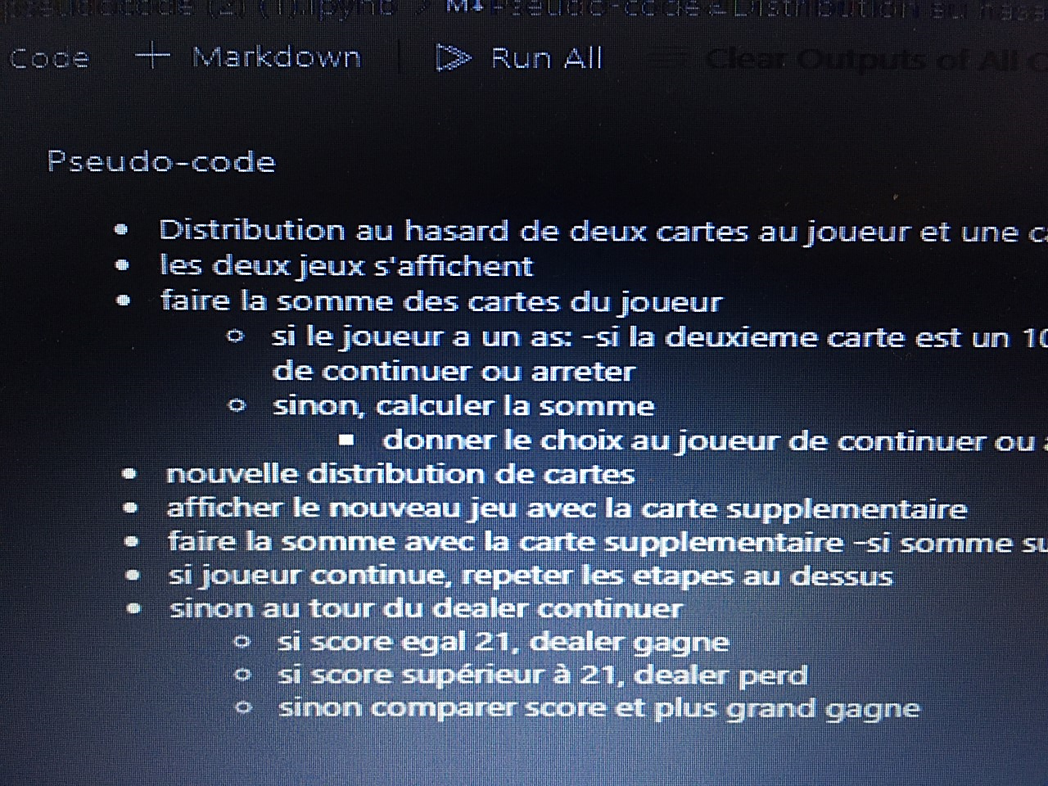
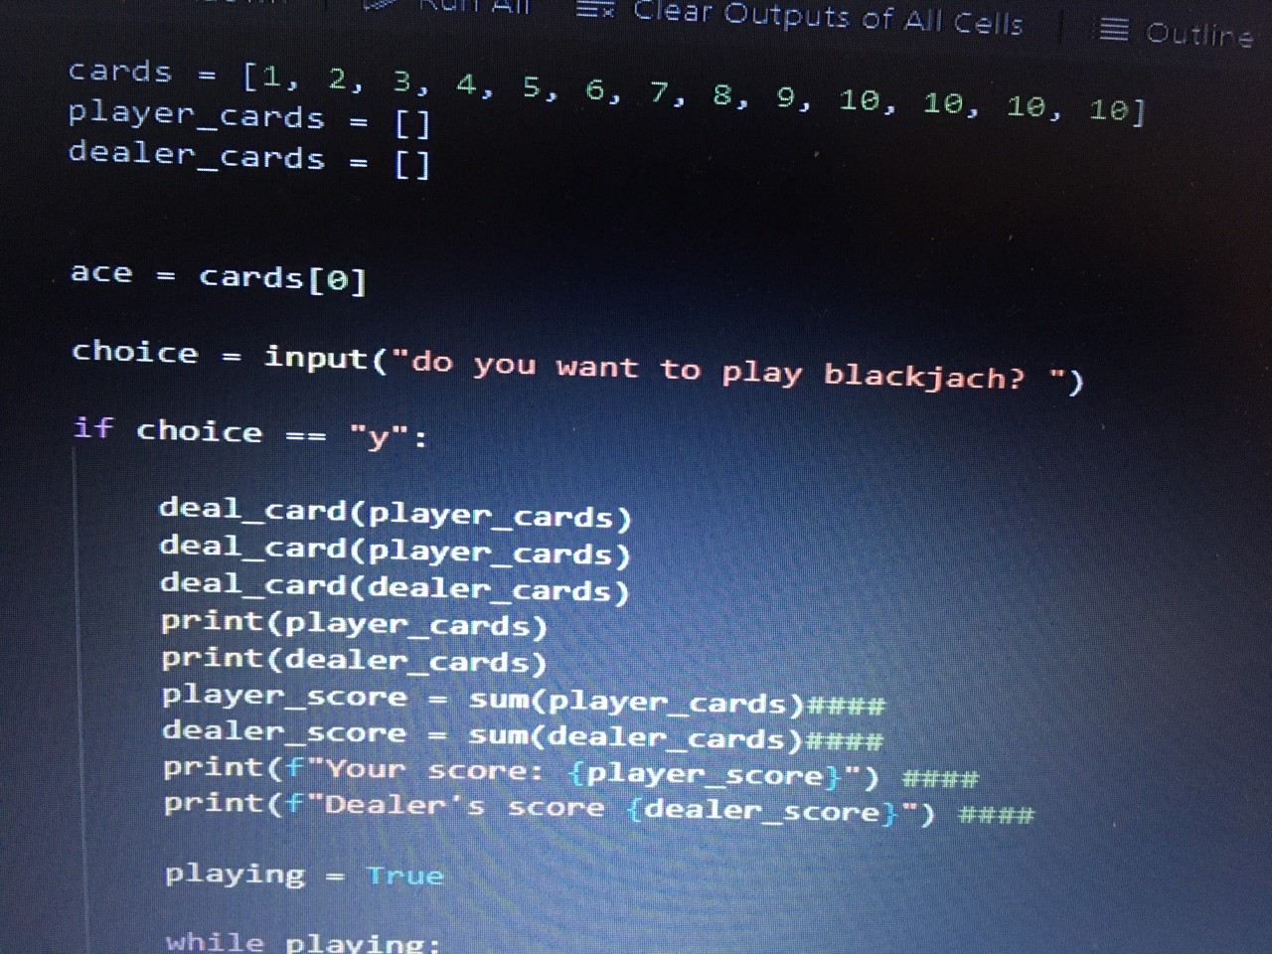
Organization
Start organization ➔ Yanis
Get used to rules ➔ Rana
Programming :
PseudoCode ➔ Sandrine
Coding ➔ all together – head of coding: Yanis
Debugging ➔ Rana, Yanis, Sandrine
Review code ➔ Yanis
Project presentation :
First Draft ➔ Sandrine
Second Draft➔ Rana
Third Draft➔ Yanis

Slide 6
Link to reposite
Link to code:
https://github.com/sandrine3375/ironsandrine/blob/main/version%202%20blackjack%20dimanche.ipynb
Link to pseudcode:
https://github.com/sandrine3375/ironsandrine/blob/main/Project1pseudocode%20(2).ipynb

Slide 7
Code
import random
def deal_card(cards_list):
"""Function do deal cards"""
random_index = random.randint(0,len(cards) - 1) # function random.randint retourne un entier au hasard, entre a et b
random_card = cards[random_index]
# append new card to deck
cards_list.append(random_card)
cards = [1, 2, 3, 4, 5, 6, 7, 8, 9, 10, 10, 10, 10]
player_cards = [] # player's card list
dealer_cards = [] # dealer's cart list

Slide 8
choice = input("do you want to play blackjach? say y ")
if choice == "y":
deal_card(player_cards) # 2*deal of card
deal_card(player_cards)
deal_card(dealer_cards) # only one deal of card for the dealer
print(player_cards)
print(dealer_cards)
player_score = sum(player_cards)
dealer_score = sum(dealer_cards)
print(f"Your score: {player_score}")
print(f"Dealer's score {dealer_score}")
if 1 in player_cards and 10 in player_cards and player_score == 11:
player_score += 10
print("You did a BlackJack!")
else: # if no blackjack, the game is going on
playing_player = True # the player starts playing

Slide 9
while playing_player: #first, the user/player is playing
keep_playing = input('do you want to continue? say y ou n') # be dealt another card
if keep_playing == "y": # the player is playing
deal_card(player_cards)
print(f"Your cards: {player_cards}")
print(f"Dealer's cards {dealer_cards}")
player_score = sum(player_cards) ####
dealer_score = sum(dealer_cards) ####
if player_score < 21: #in this case, loop is going on, we ask again "do yu want to continue"
print(f"Your score: {player_score}")
print(f"Dealer's score {dealer_score}")
elif player_score == 21: # inthis case, loop stop, player wins
print("you win!!! you have 21") #####
playing_player = False
else: # inthis case, loop stop, dealer wins
print("Dealer wins, you did more than 21")
playing_player = False
First loop -Player

Slide 10
else: #dealer is playing because the playser said "n" (not playing)
playing_player = False #player loop stop
deal_card(dealer_cards)
print(f"Your cards: {player_cards}")
print(f"Dealer's cards {dealer_cards}")
player_score = sum(player_cards)
dealer_score = sum(dealer_cards)
if player_score < dealer_score:
print("The dealer wins! You lose!!!!!")
elif dealer_score == 21:
print("The dealer blackjack! You lose!!!!!")
elif dealer_score < 17 :
dealer_playing = True # le dealer keep playing until the cards are equal to 17

Slide 11
elif dealer_score < 21:
if player_score > dealer_score and dealer_score < 17:
print("dealer continue") # le loop continue
elif dealer_score >= 17 and player_score > dealer_score :
print("You win, your score is higher")
dealer_playing = False
elif dealer_score == 17 and player_score ==17 :
print("you are equals, no winner")
dealer_playing = False
elif player_score < dealer_score:
print("The dealer wins! You lose!!!!!")
dealer_playing = False
while dealer_playing:
deal_card(dealer_cards)
print(f"Dealer's cards {dealer_cards}")
dealer_score = sum(dealer_cards)
if dealer_score == 21:
print("Dealers wins")
dealer_playing = False
elif dealer_score > 21:
print ("you win, the dealer did more than 21")
dealer_playing = False
Second loop -Dealer

Slide 12
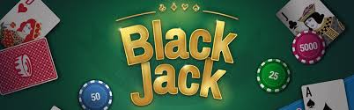
Thanks

